Slide 1

GETTING TO KNOW EACH OTHER: THIS OR THAT
PHYSICAL EDUCATION

Slide 2

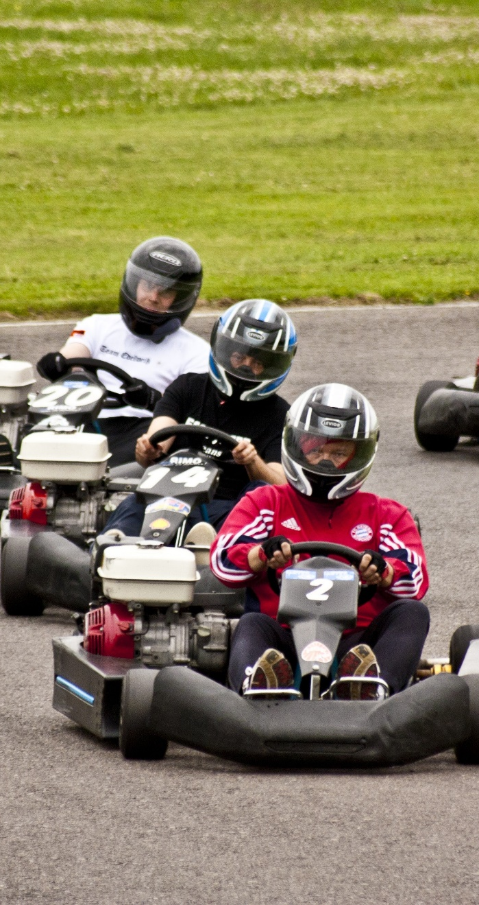
LASER TAG
TEST RUN
GO KARTS
RULES
LOCATE AREA 1 AND AREA 2.
THE PICTURE ON THE LEFT WILL REPRESENT AREA 1 AND THE PICTURE ON THE RIGHT WILL REPRESENT AREA 2.
ON THE INSTRUCTOR'S DIRECTIVE GO TO THE RESPECTIVE AREA BASED ON THE CONCEPT YOU PREFER THE MOST (YOU CAN ONLY CHOOSE ONE).
YOU HAVE 5 SECONDS TO GET TO EACH AREA WHEN THE SLIDE CHANGES.

Slide 3


SCIENCE
MATH

Slide 4


SOCIAL STUDIES
ENGLISH

Slide 5


READ
WRITE

Slide 6

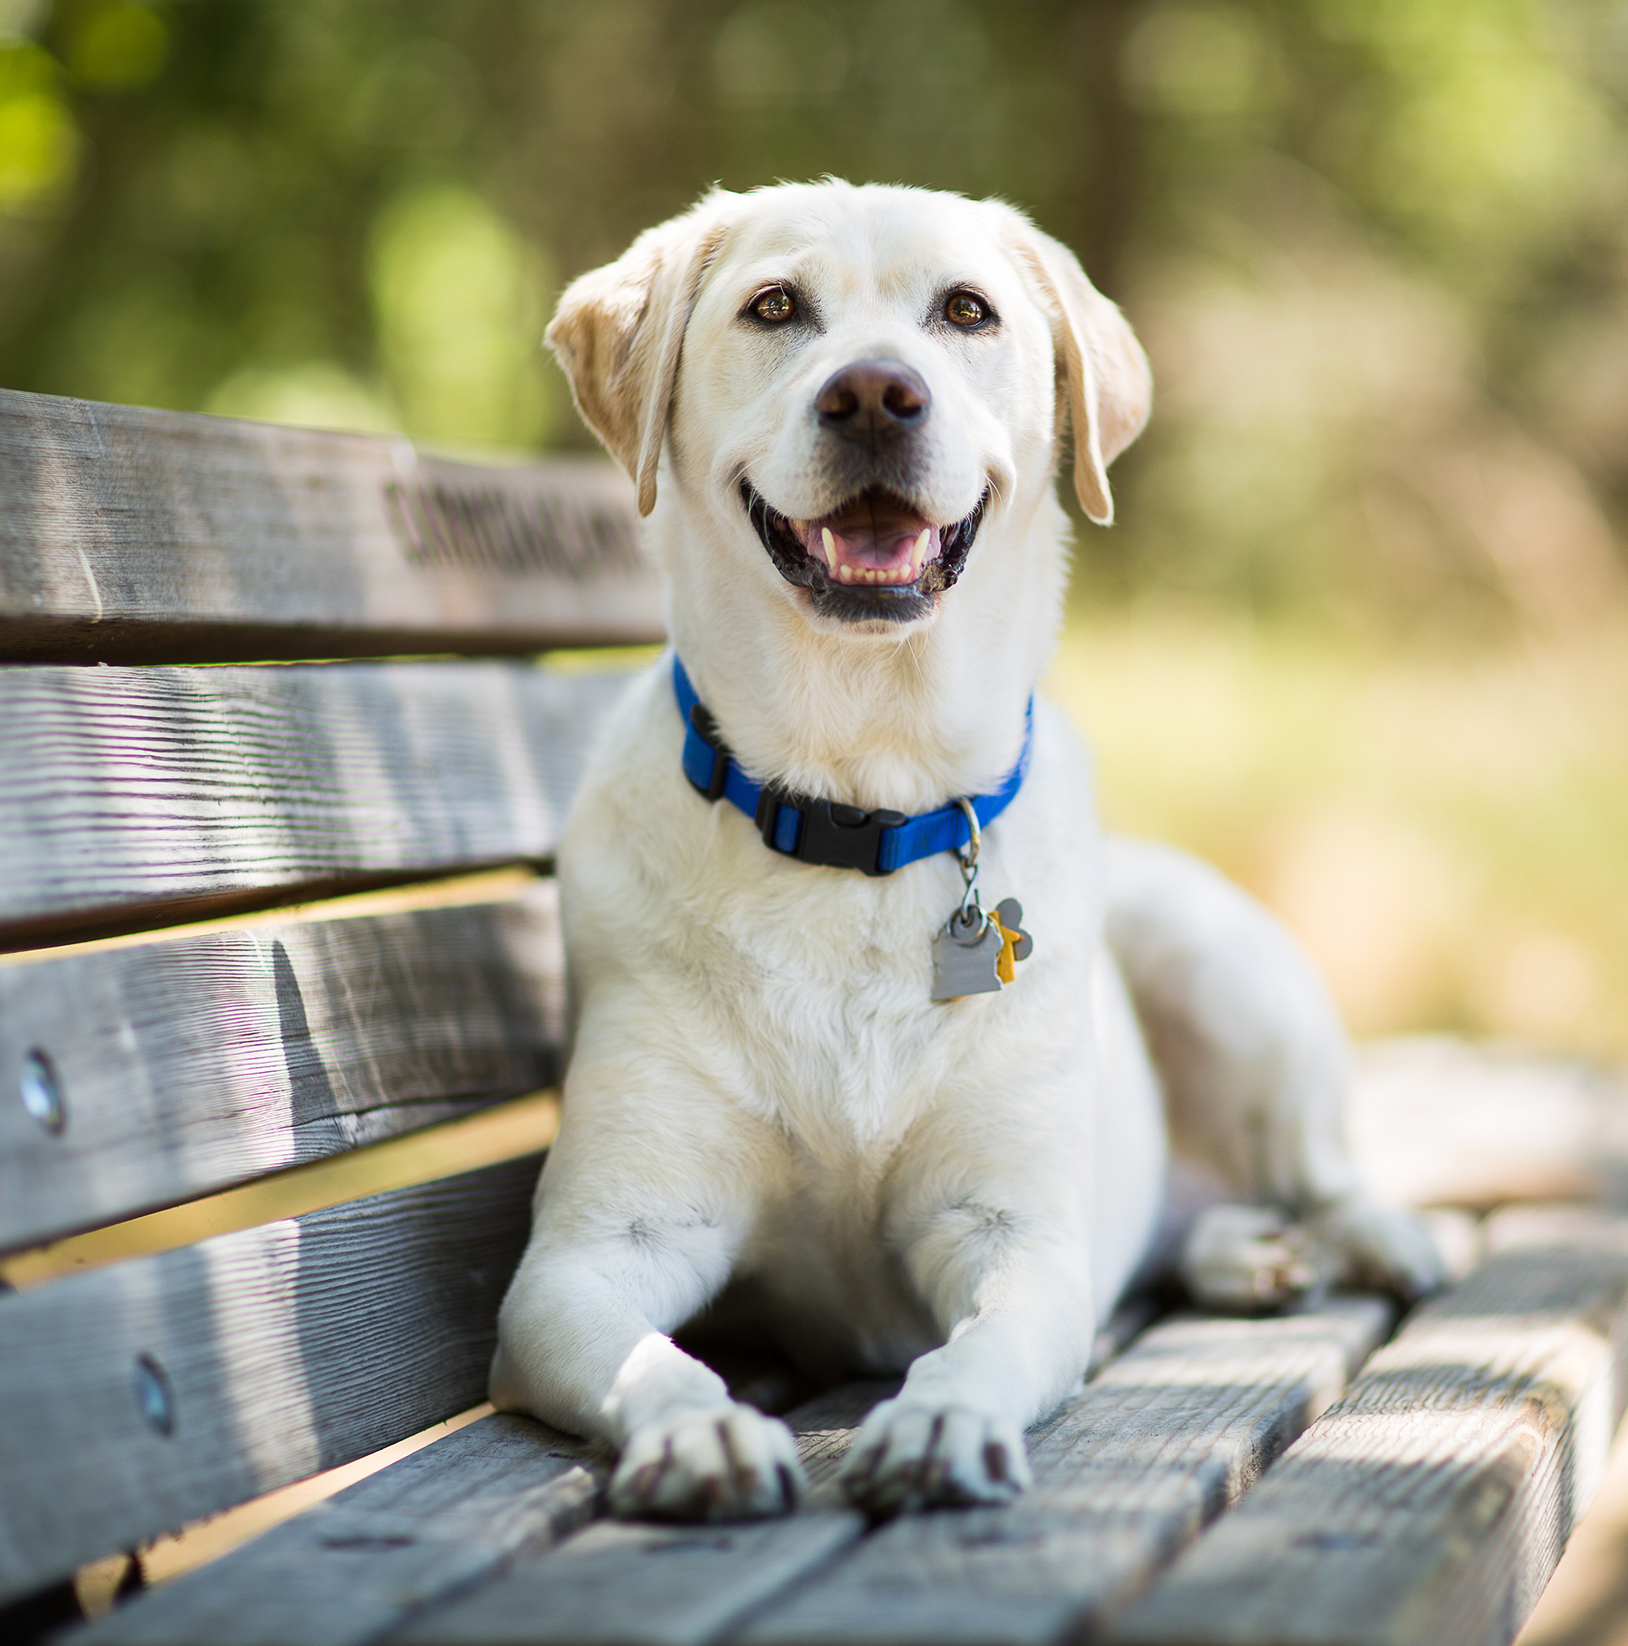
CAT
DOG

Slide 7


NIKE
ADIDAS

Slide 8


BASKETBALL
BASEBALL

Slide 9
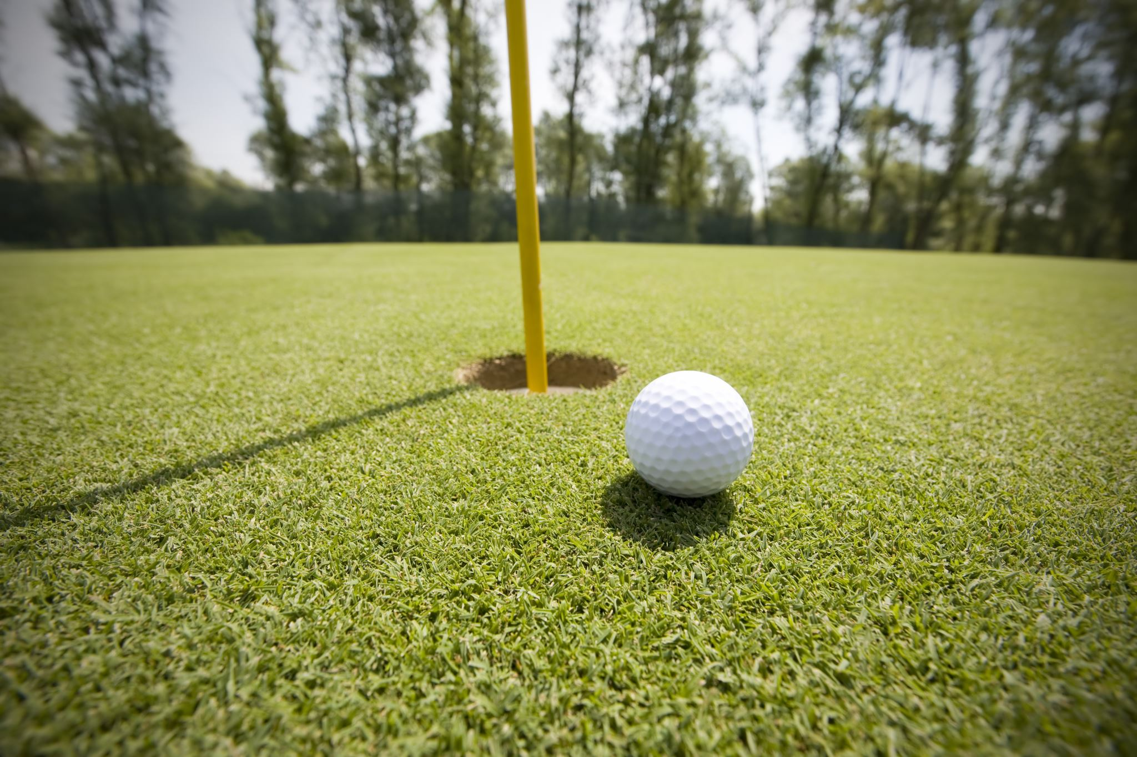
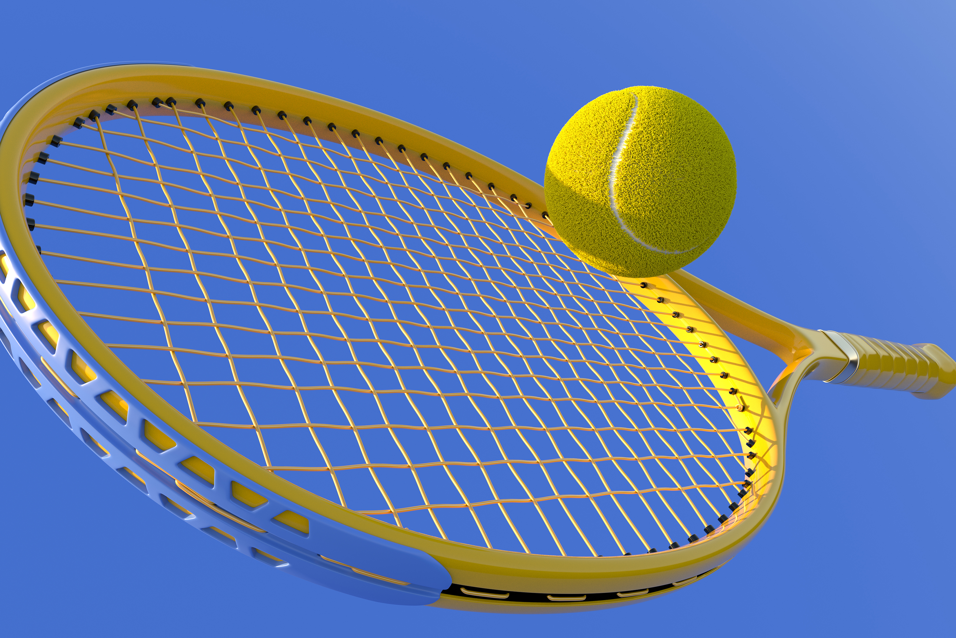
GOLF
TENNIS

Slide 10


SOCCER
FOOTBALL

Slide 11
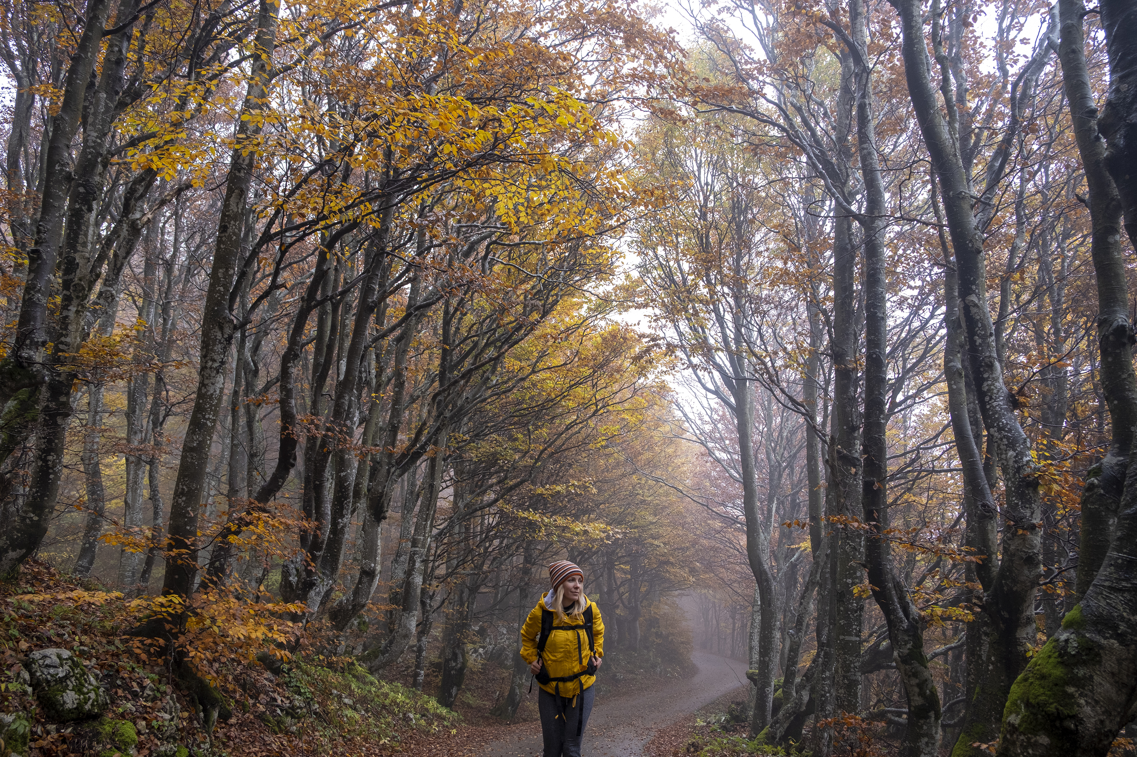
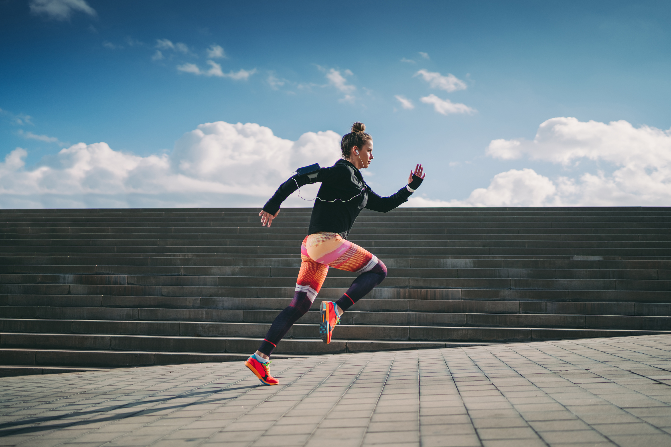
WALK
JOG/RUN

Slide 12

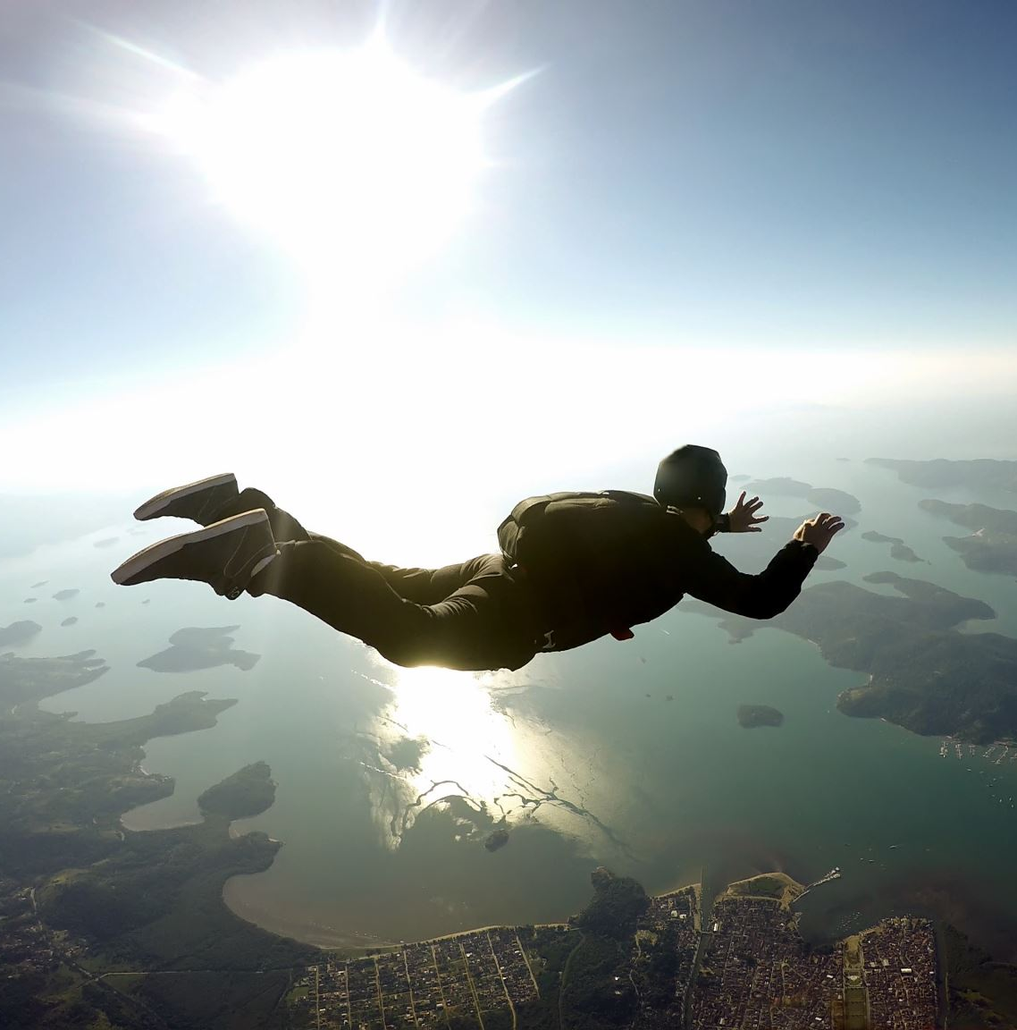
SCUBA DIVING
SKY DIVE

Slide 13


PLAYSTATION
XBOX

Slide 14
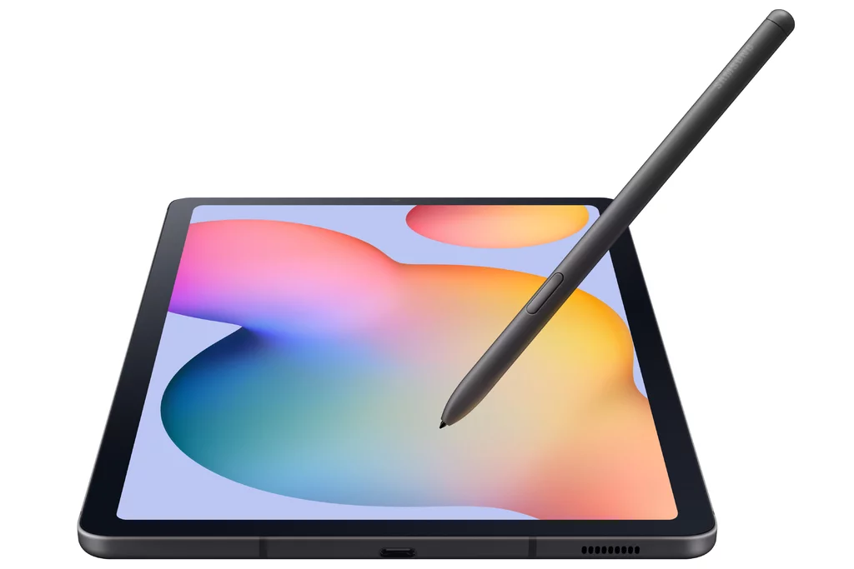
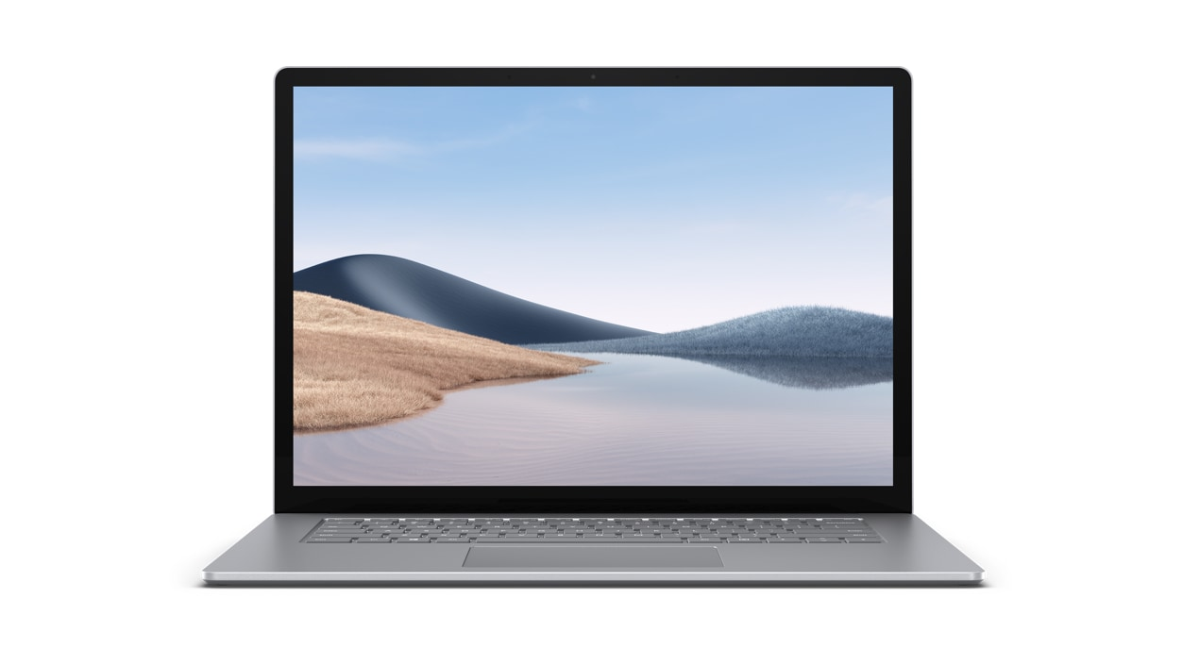
LAPTOP
TABLET

Slide 15
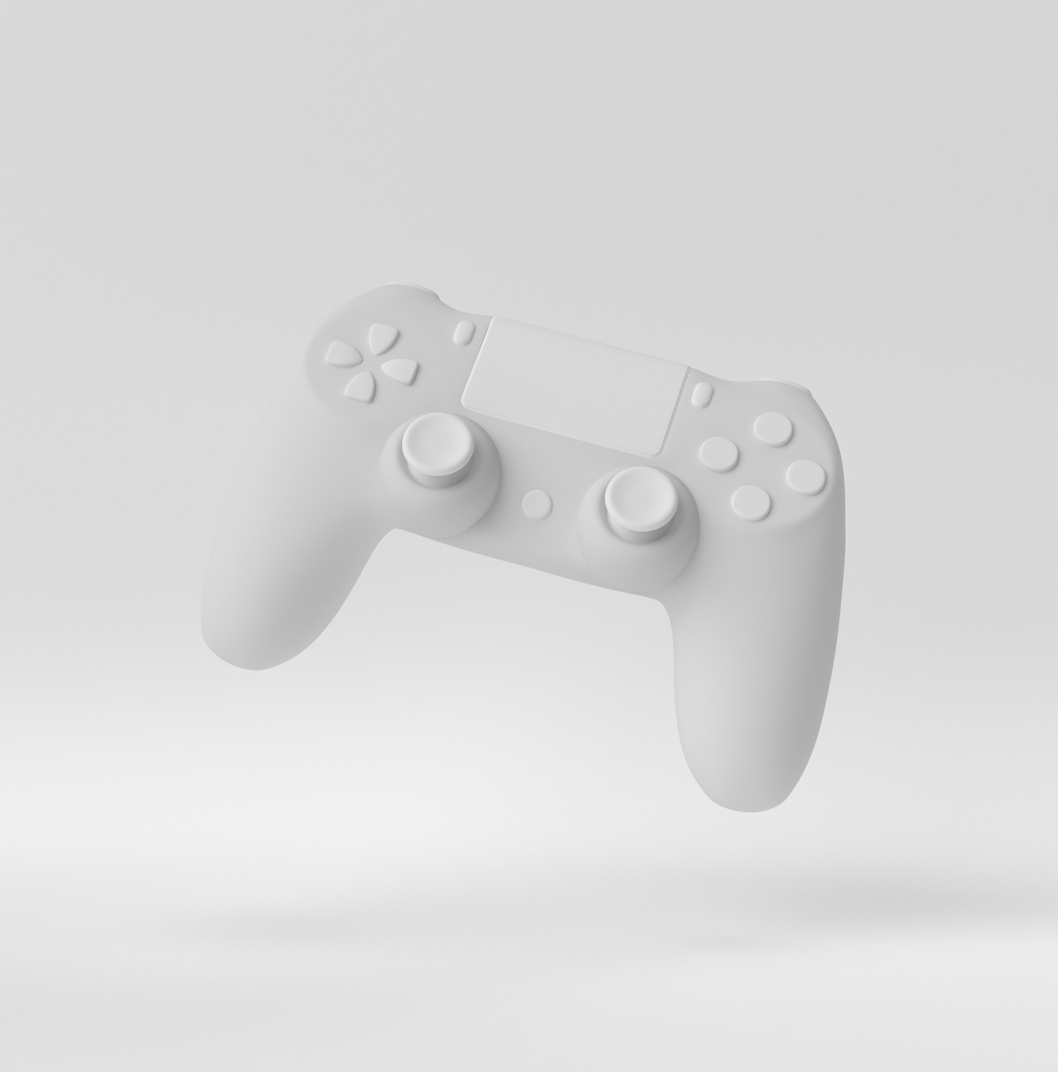

VIDEO GAMES
MOVIES

Slide 16
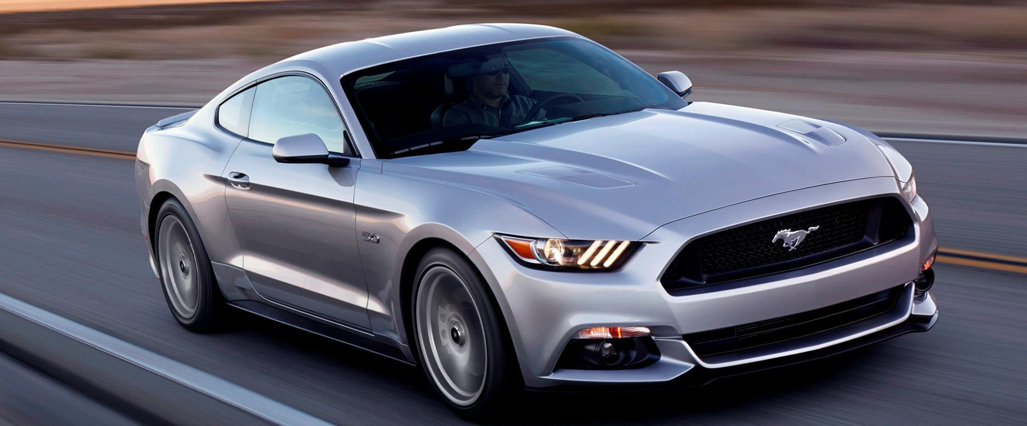
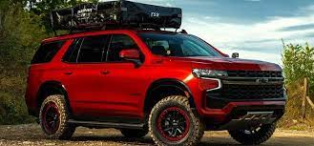
CAR
TRUCK

Slide 17


POOL
BEACH

Slide 18


APPLE
ANDROID

Slide 19


INSTAGRAM
TIK TOK

Slide 20


FORTNITE
NBA 2K

Slide 21


NETFLIX
HULU

Slide 22


HARRY POTTER
STAR WARS

Slide 23




Slide 24
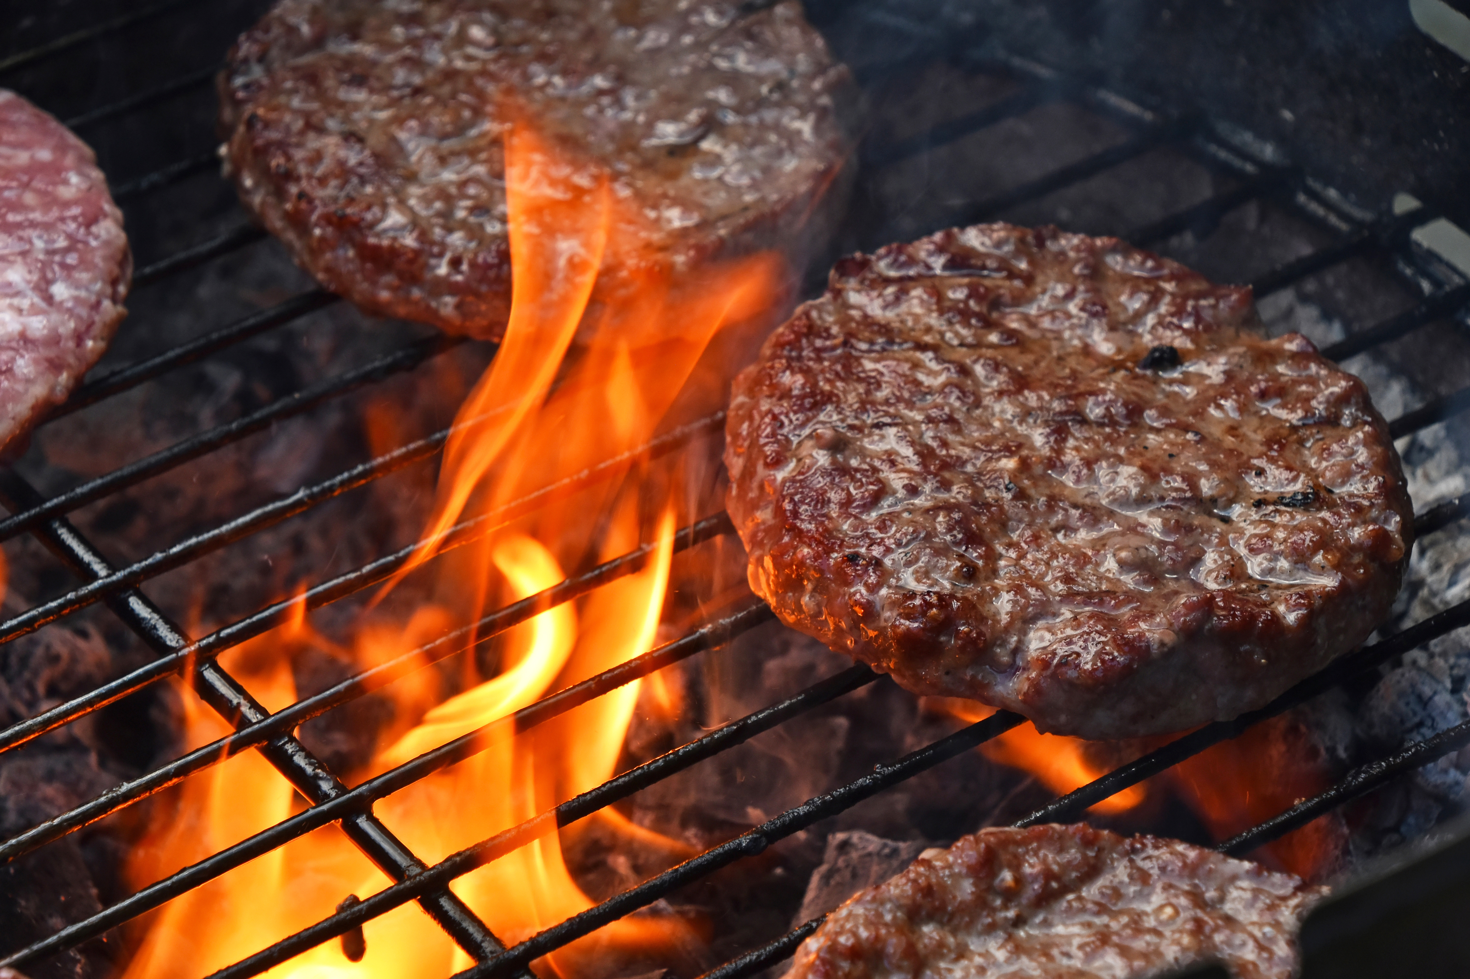
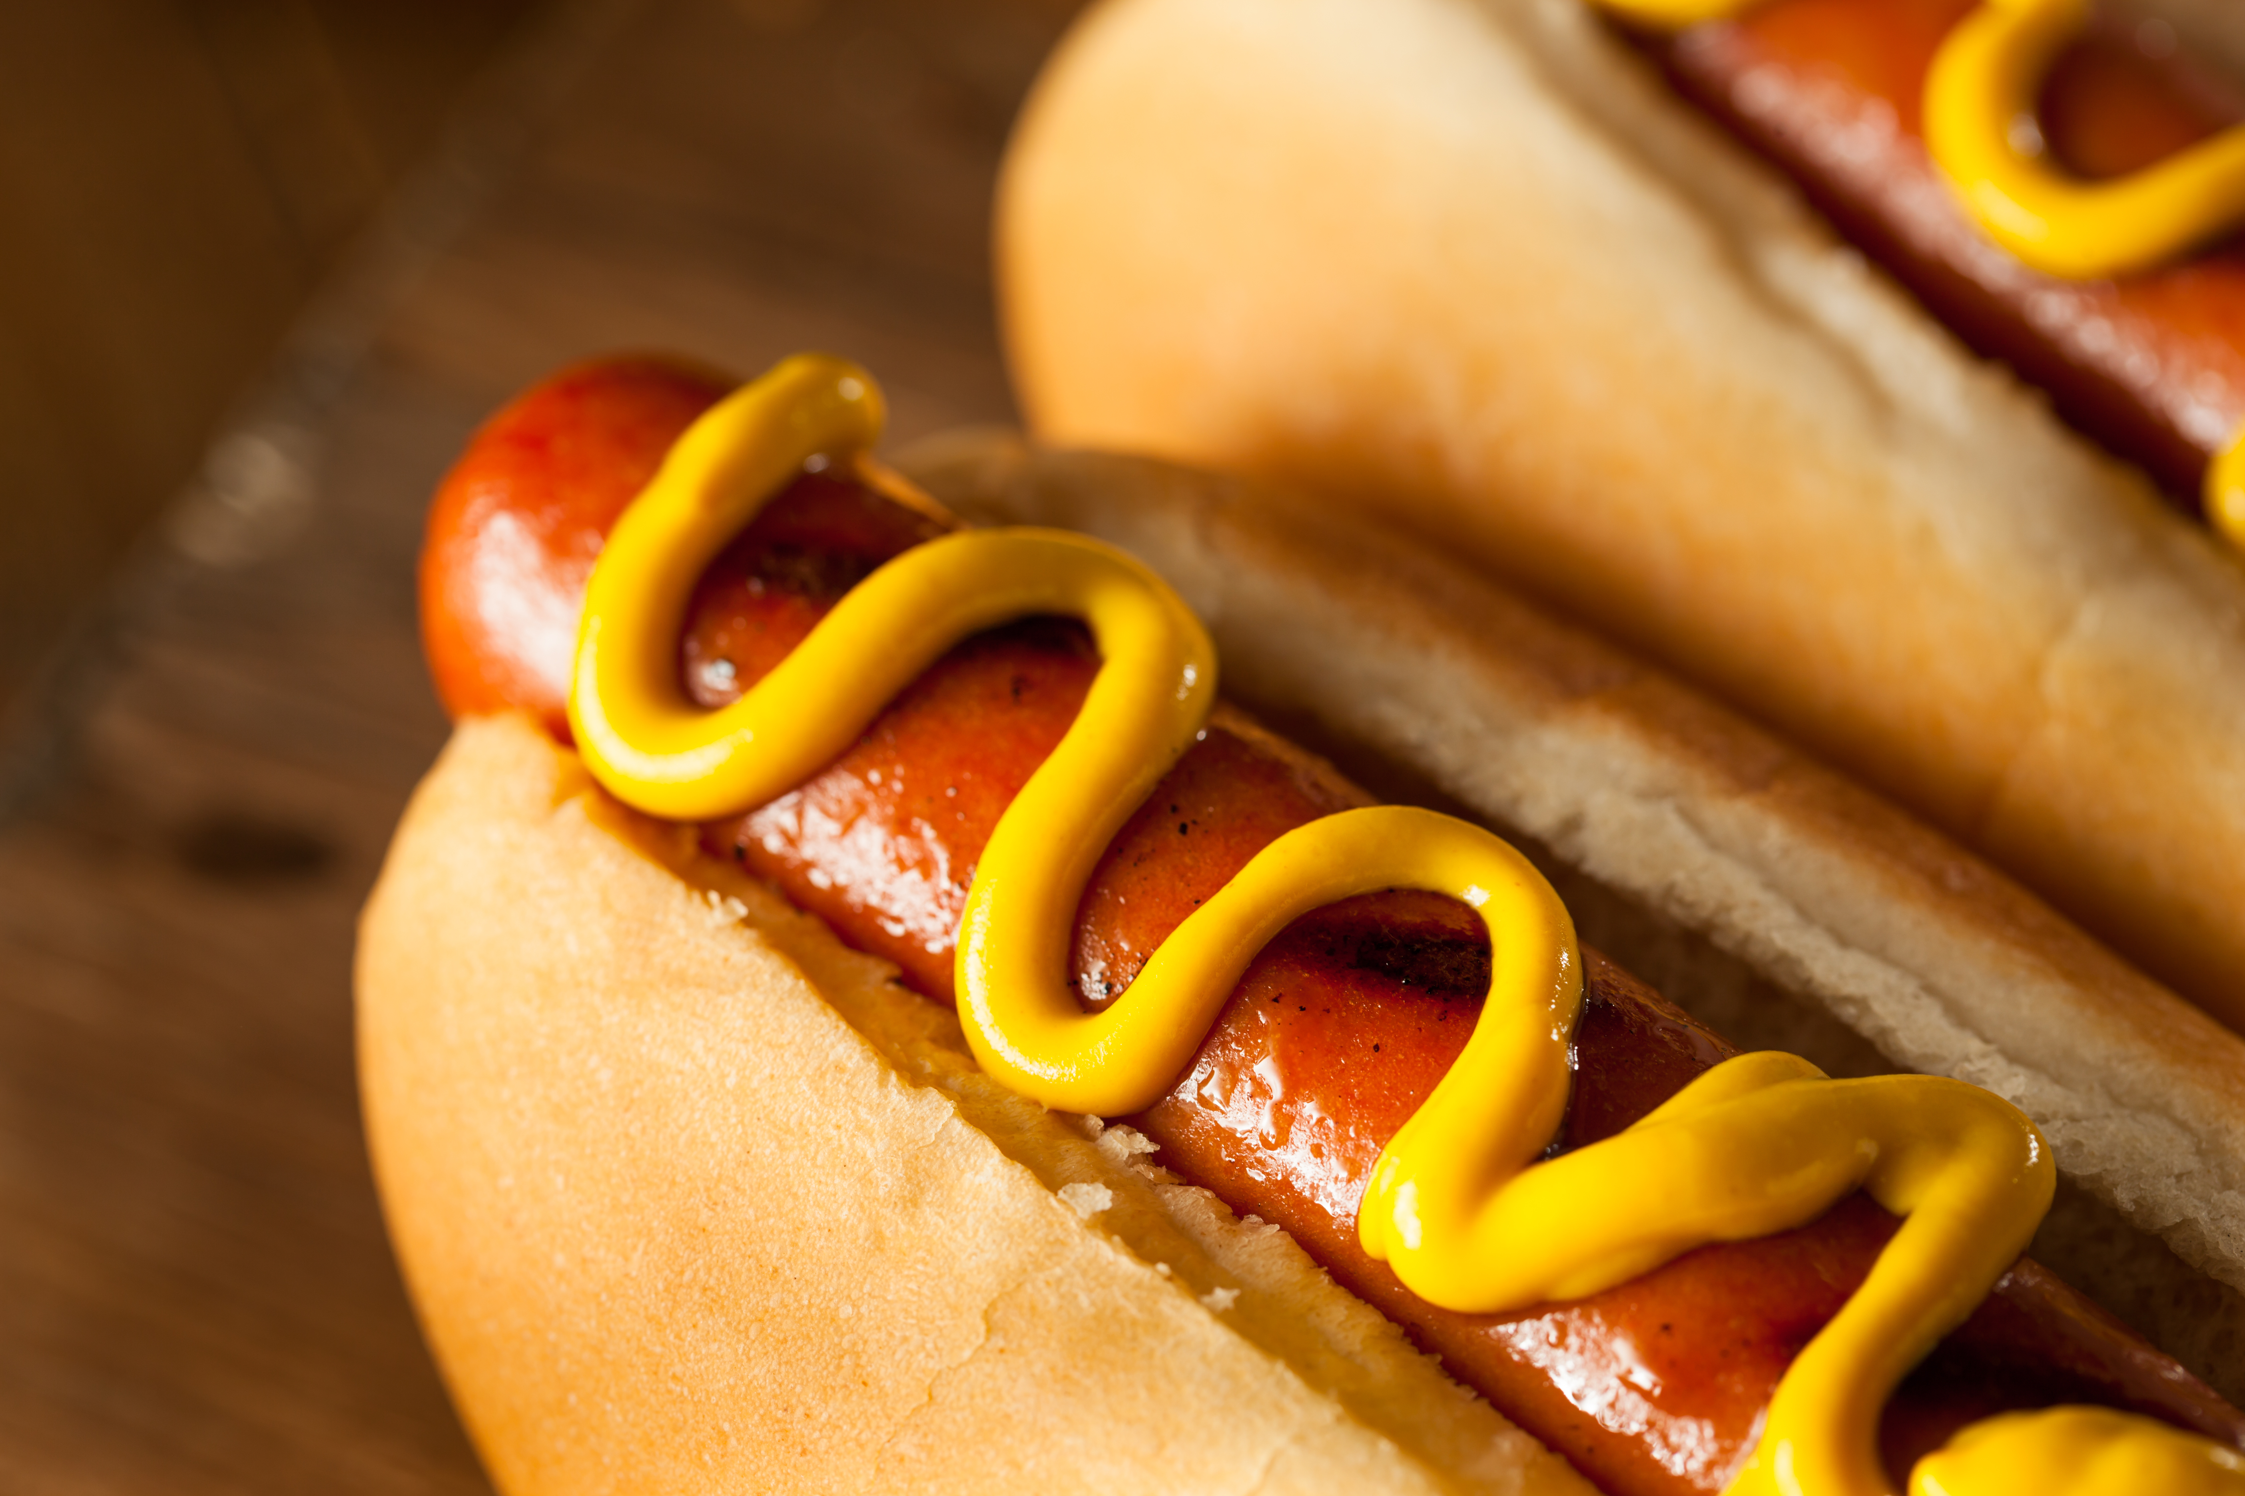
HAMBURGER
HOT DOG

Slide 25


MCDONALD'S
CHICK-FIL-A

Slide 26


SMOOTHIE KING
TROPICAL SMOOTHIE

Slide 27
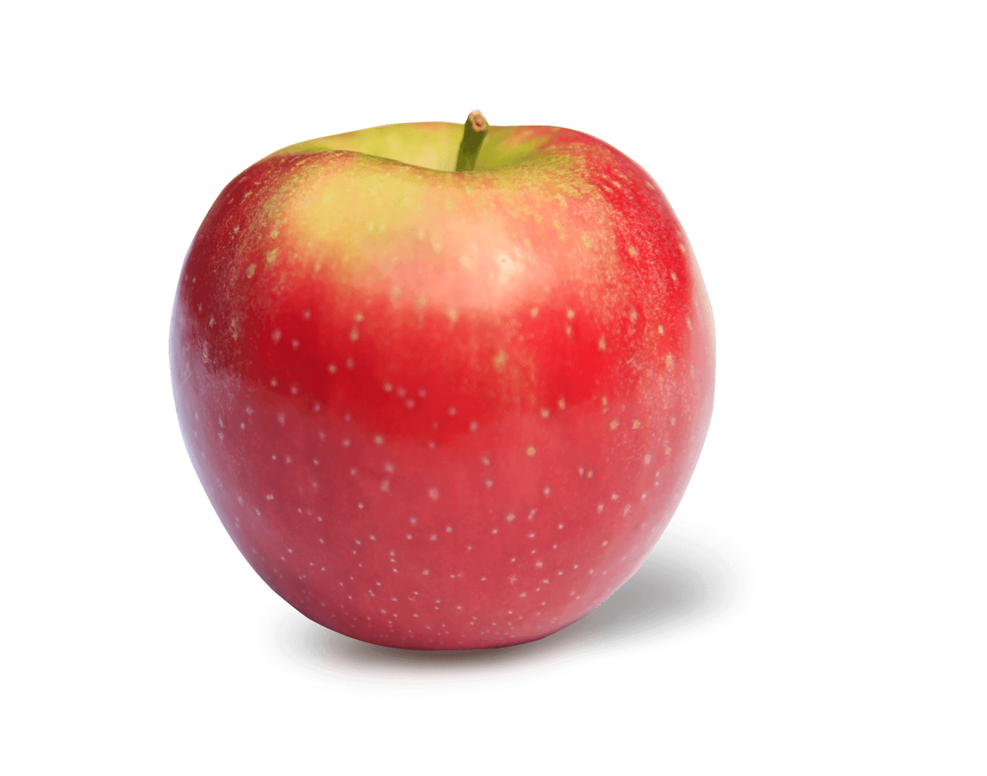

APPLE
BANANA

Slide 28
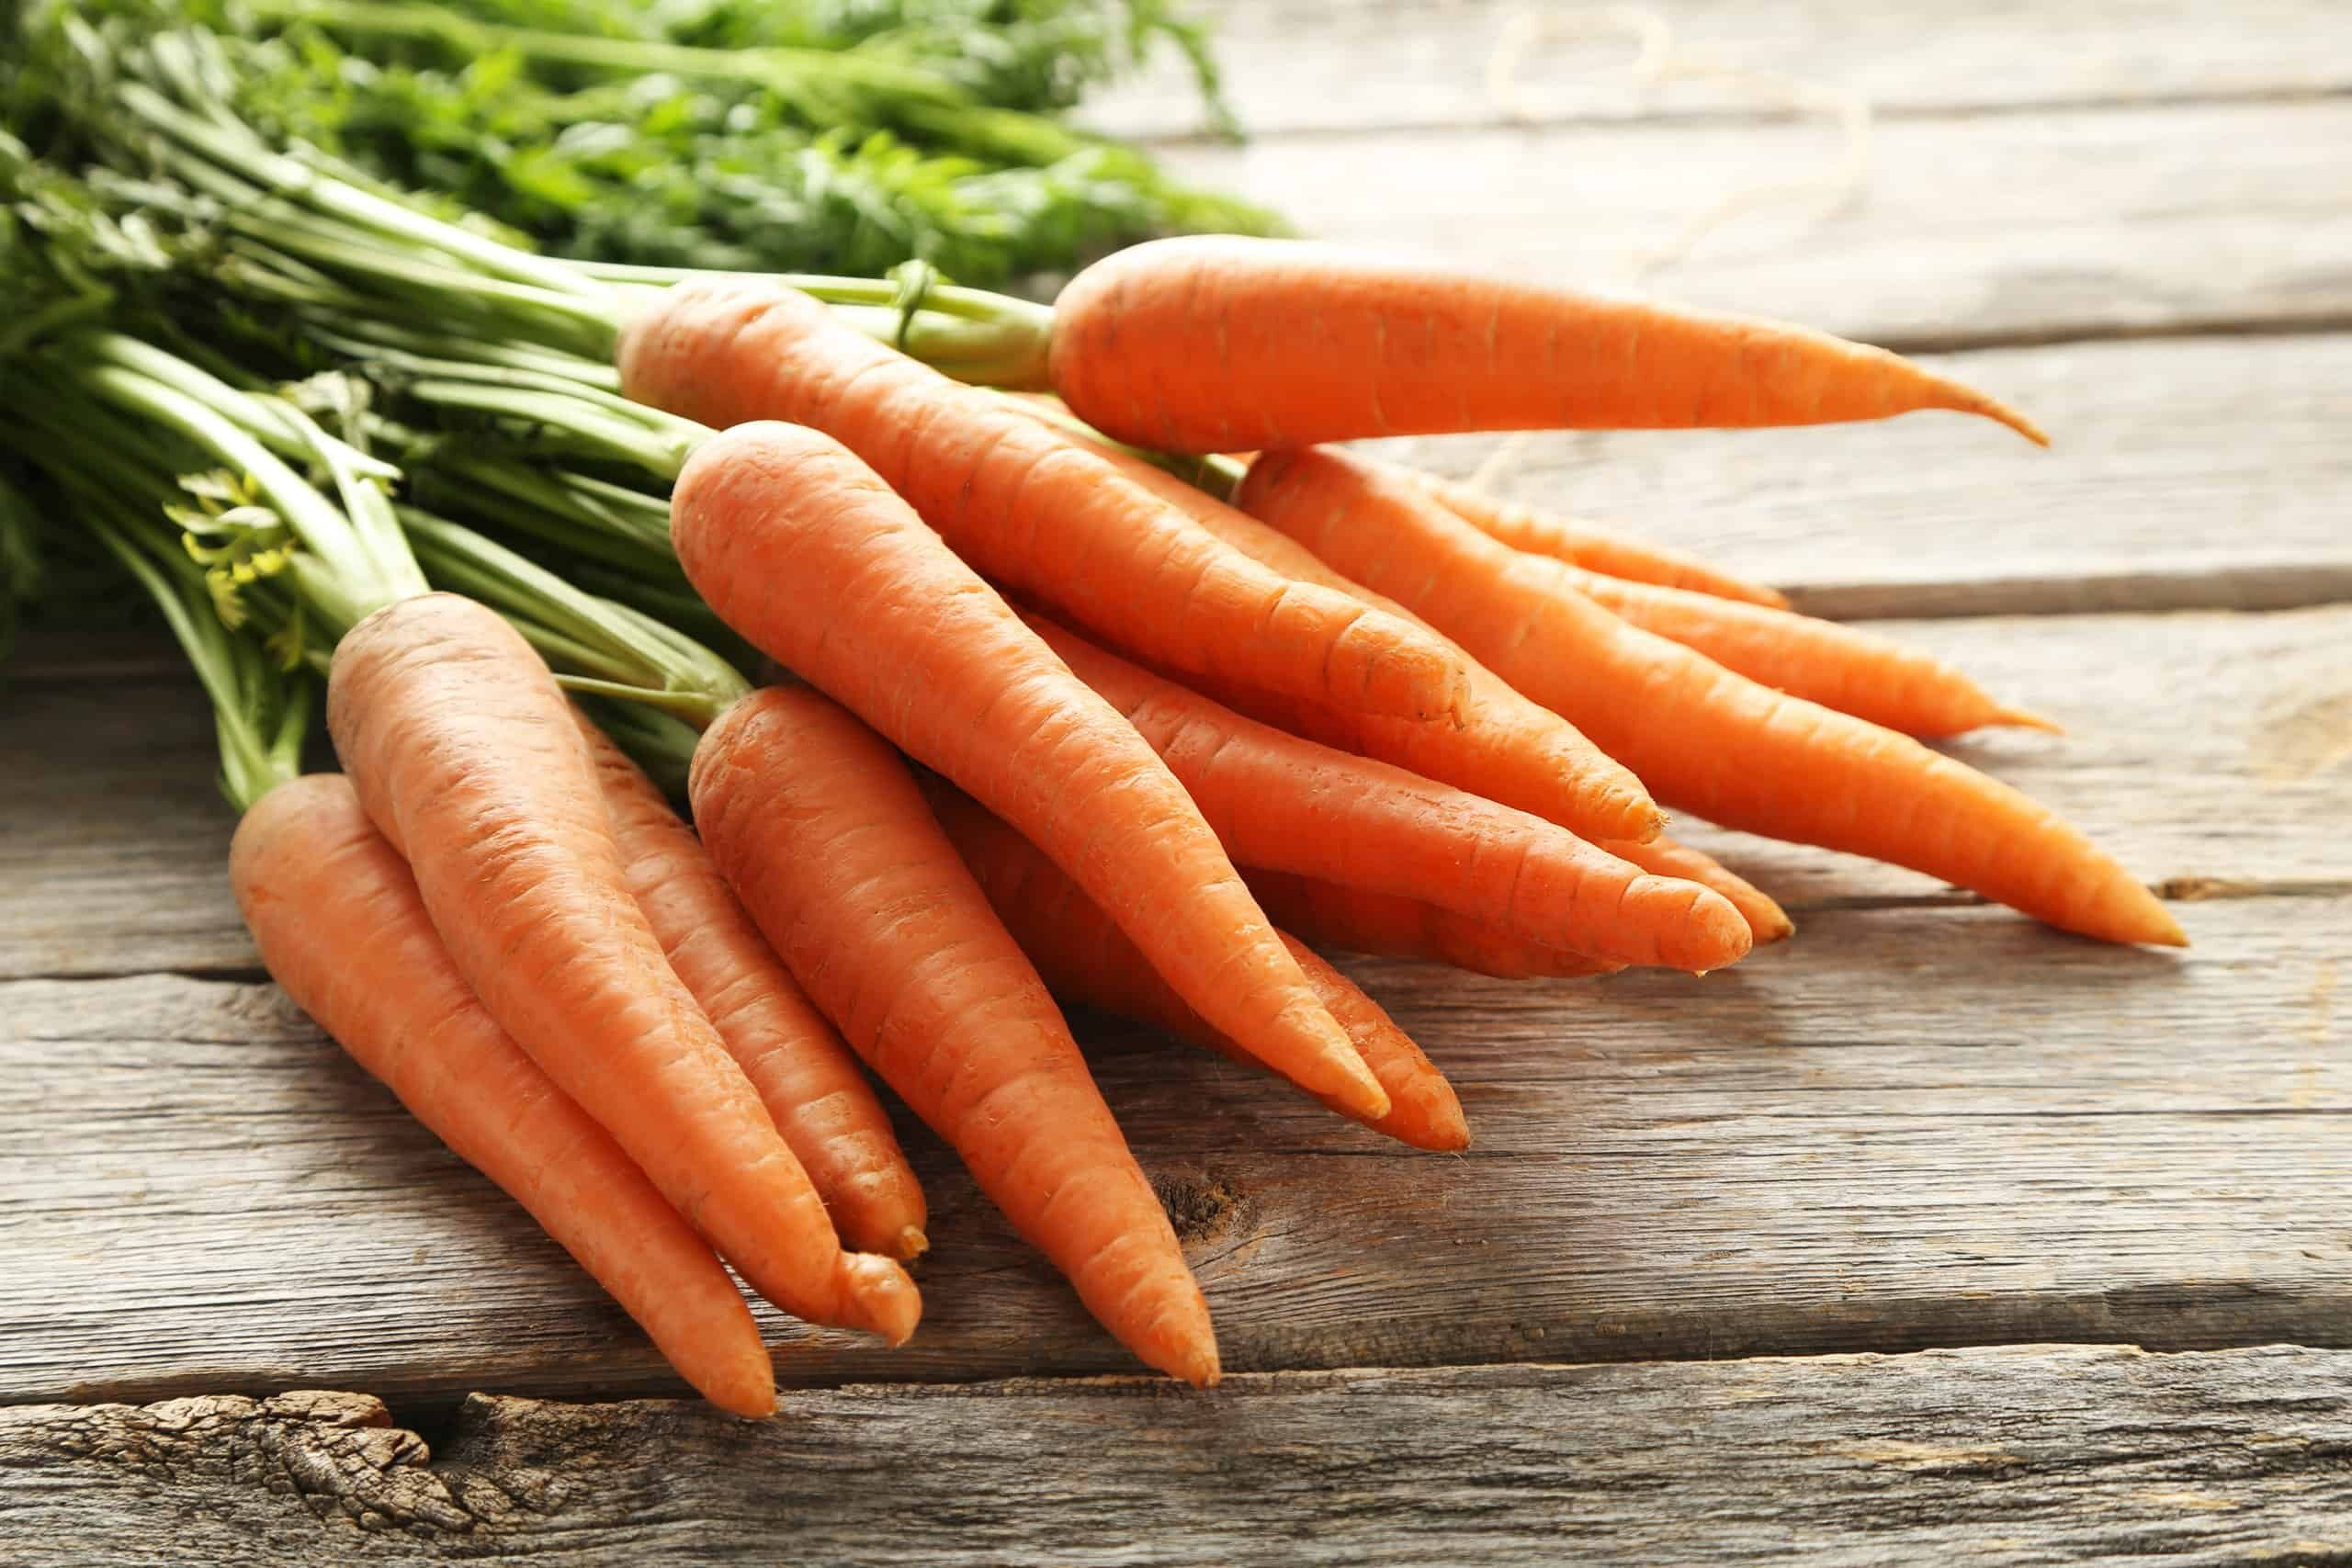
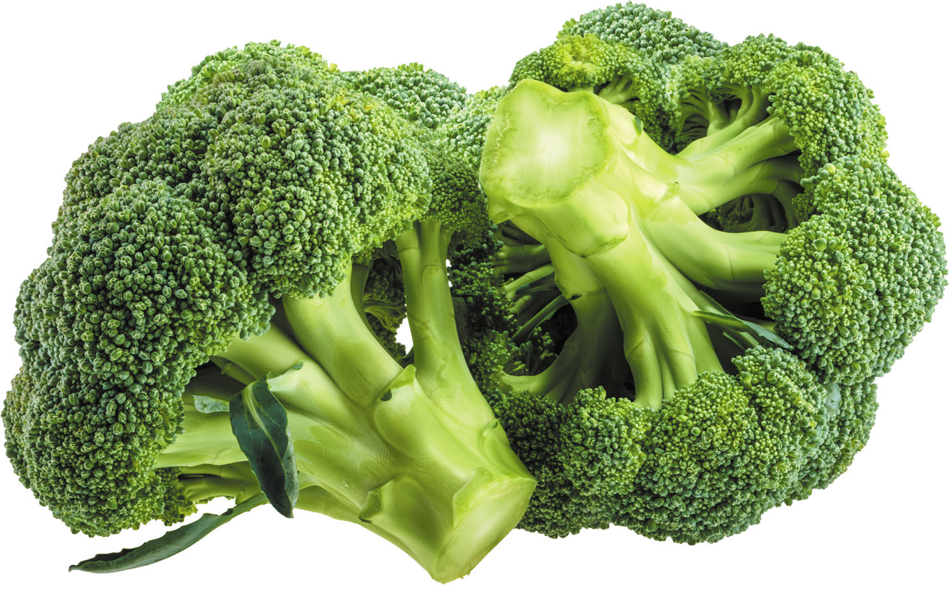
BROCCOLI
CARROTS

Slide 29
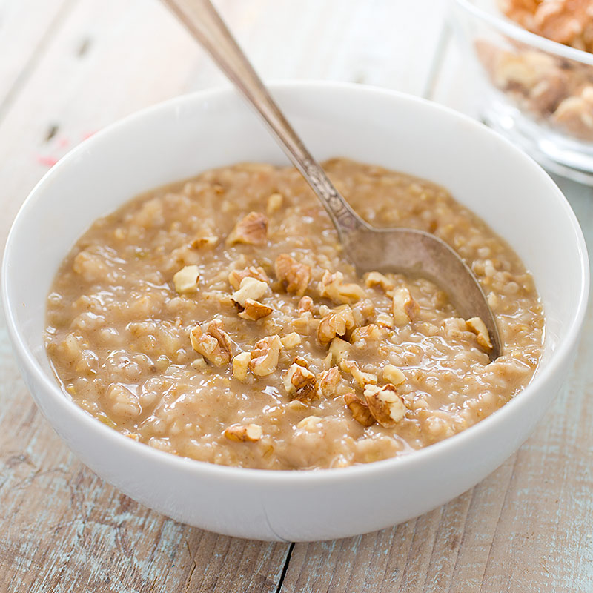
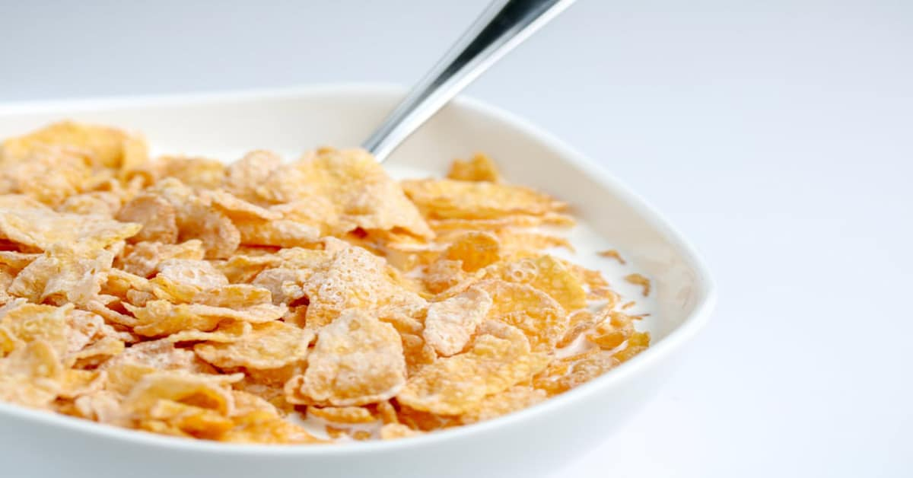
CEREAL
OATMEAL

Slide 30

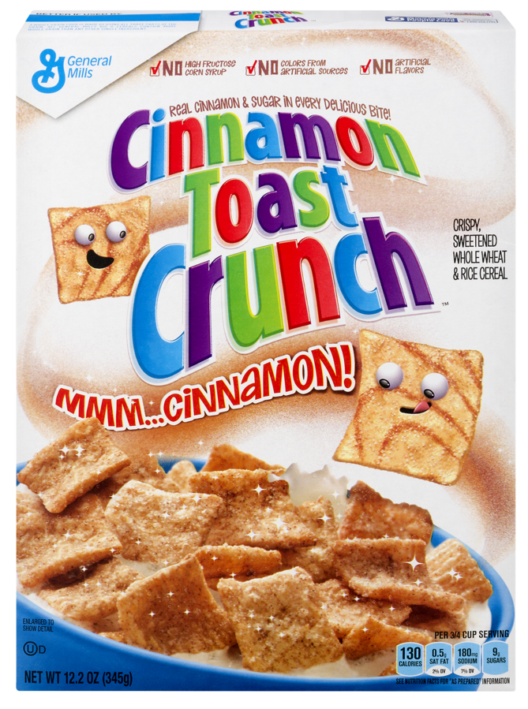
FROSTY FLAKES
CINNAMON TOAST CRUNCH

Slide 31
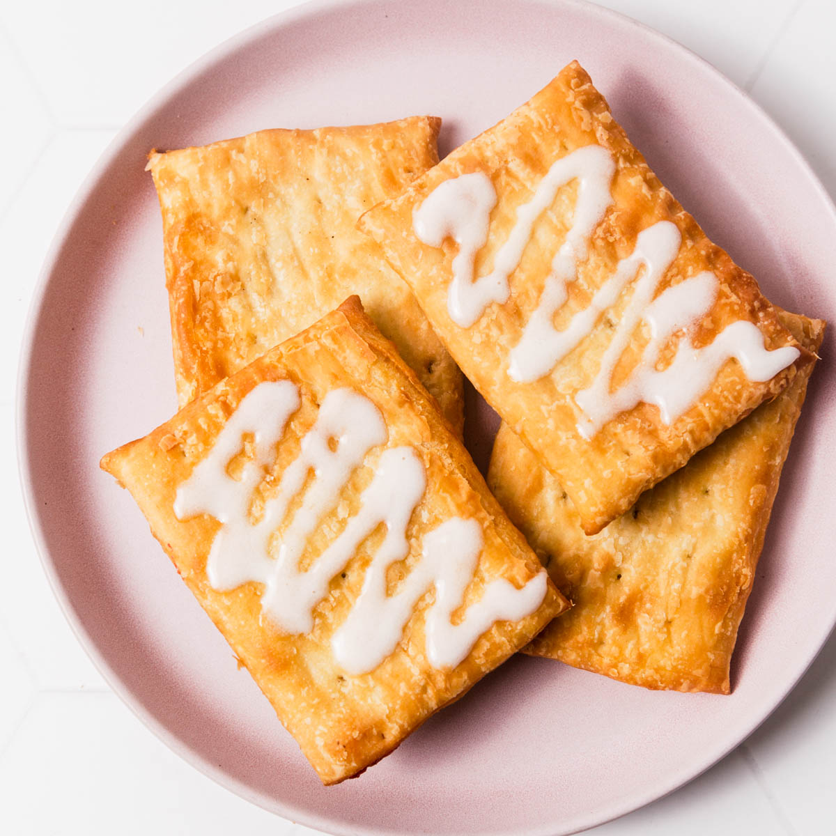
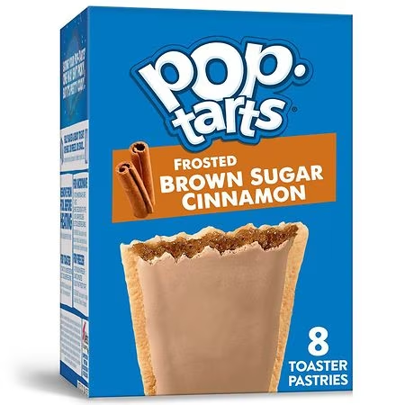
TOAST STRUDEL
POP TARTS

Slide 32
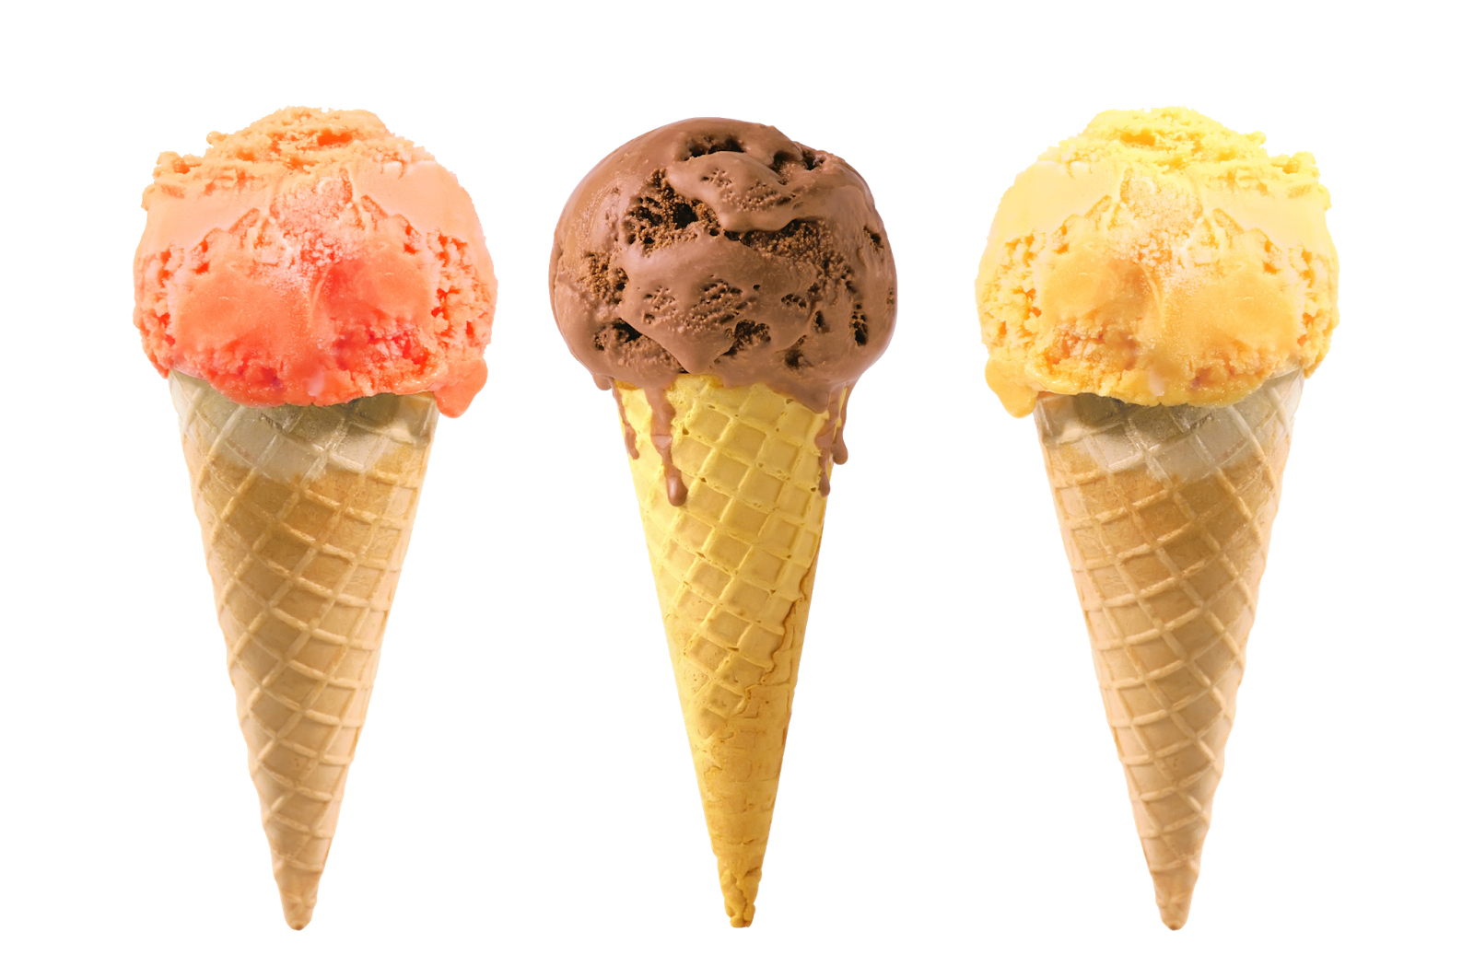
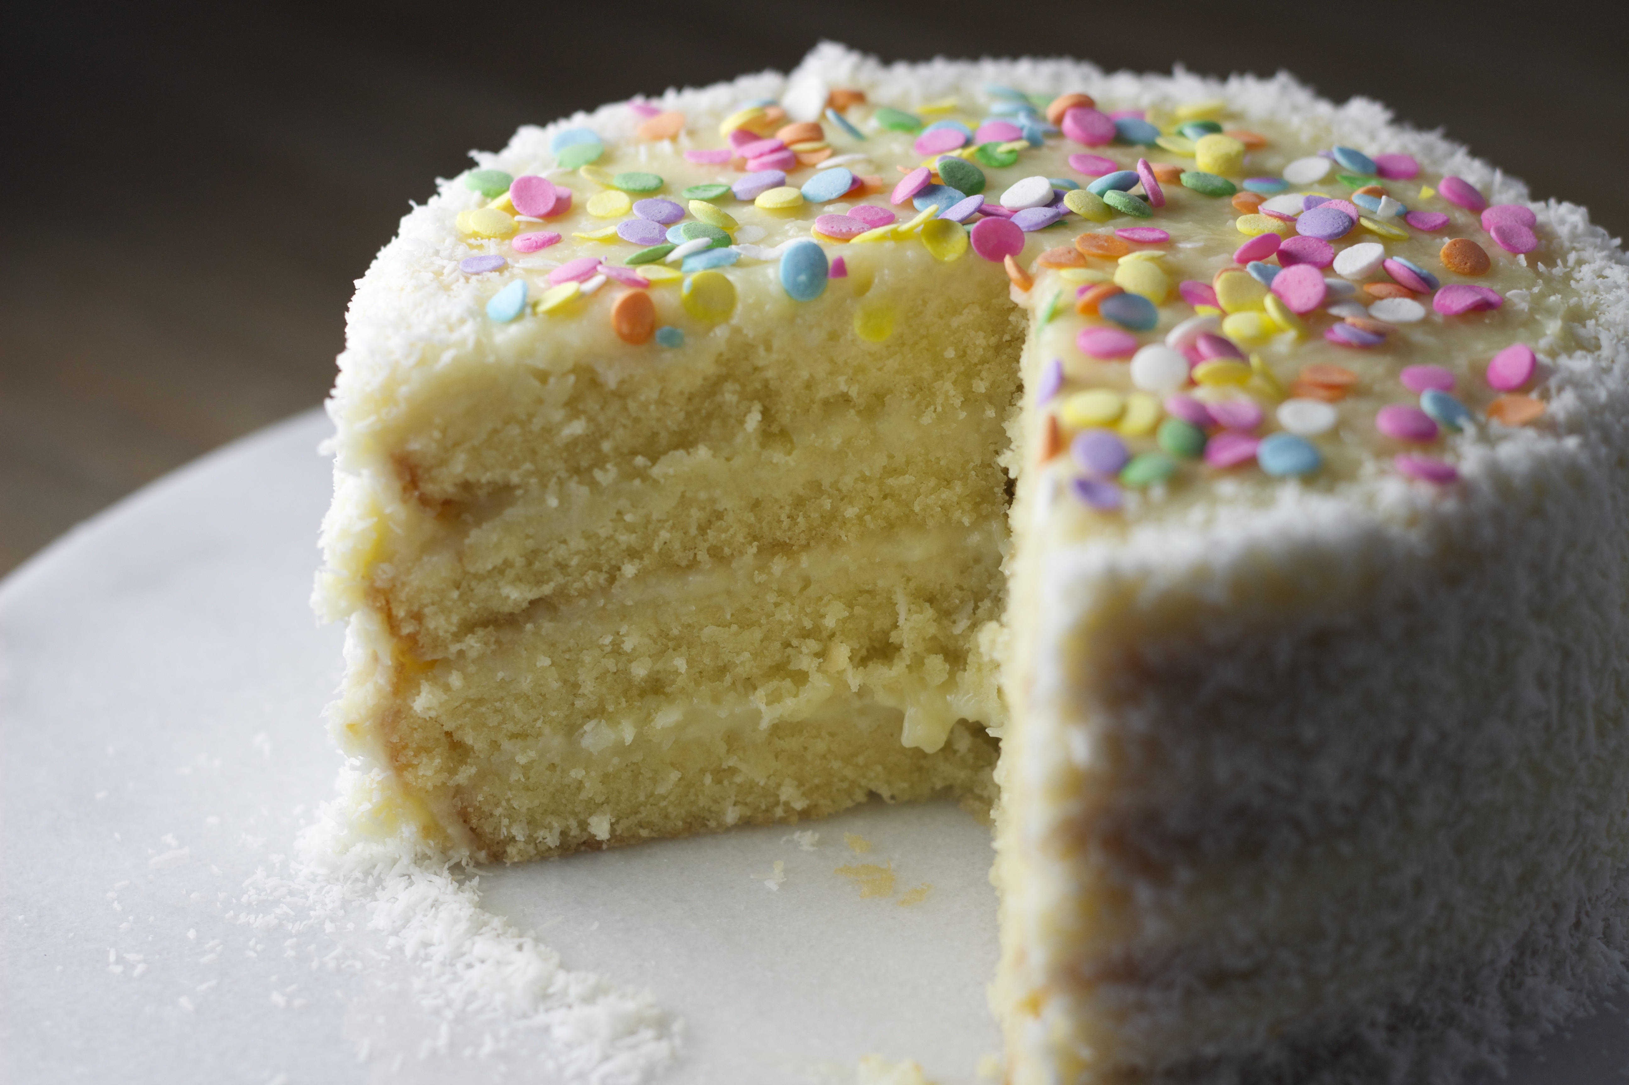
ICE CREAM
CAKE

Slide 33
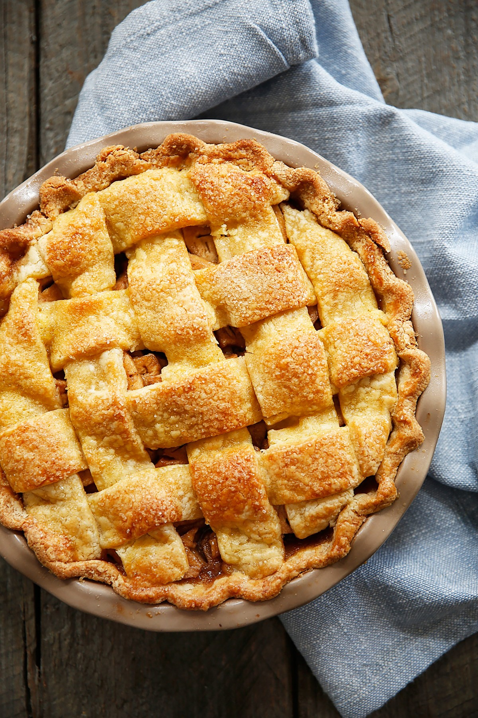
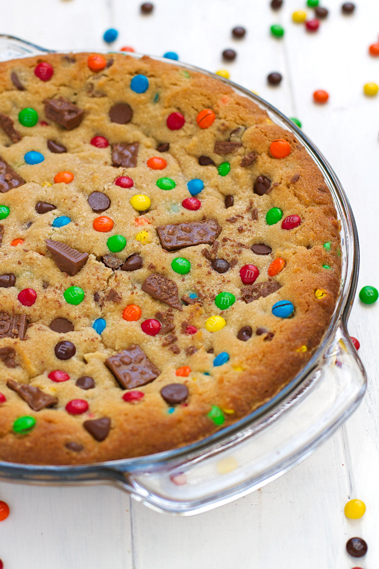
PIE
COOKIE CAKE

Slide 34


SNICKER
TWIX

Slide 35

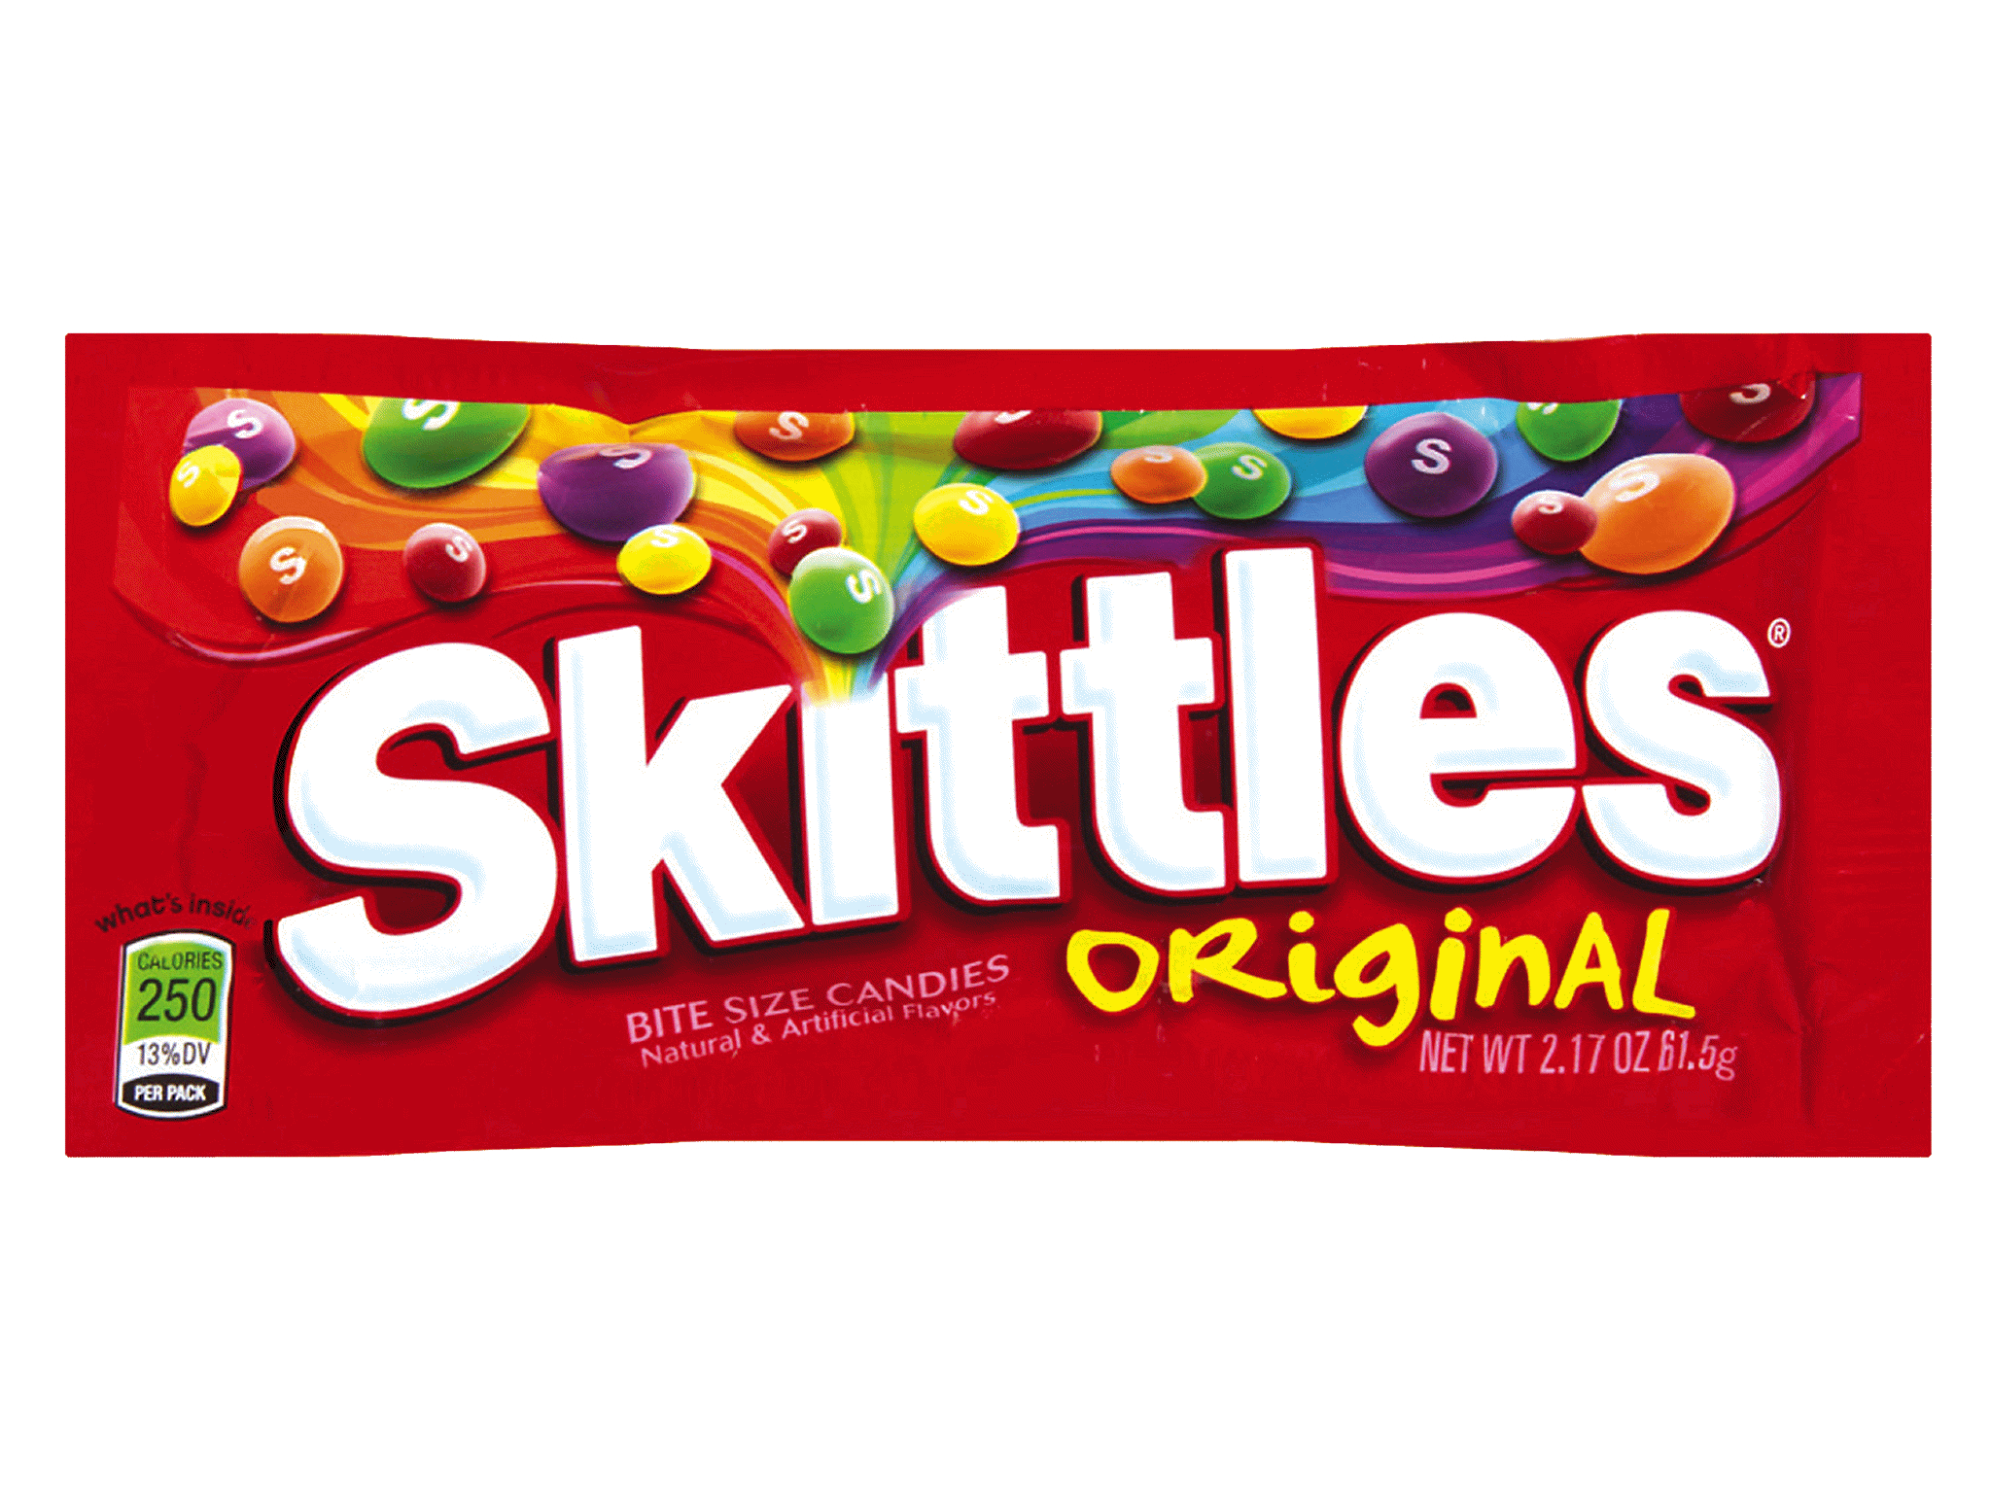
SOUR PATCH KIDS
SKITTLES

Slide 36

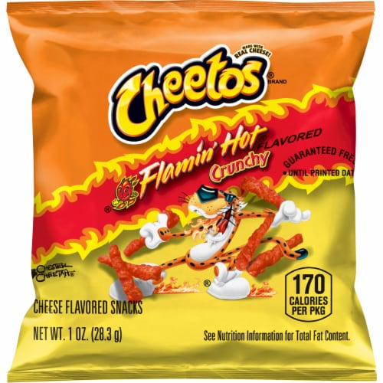
TAKIs
HOT CHEETOS

